Slide 1
Flowchart and Algorithm
Md. Fazlul Karim Patwary
IIT

Slide 2
Algorithm
A sequence of step-by-step instructions to solve a problem is called Algorithm.
Graphical or pictorial representation of the instructions to solve a problem is called Flowchart.

Slide 3
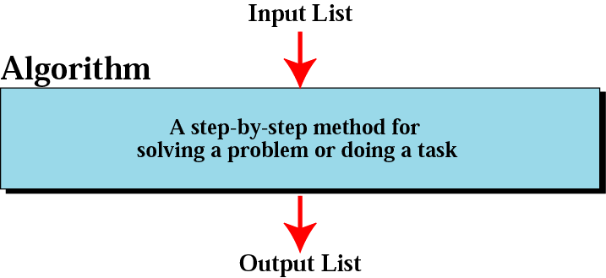
Informal definition of an algorithm
used in a computer

Slide 4
Algorithm: Example
Algorithm to rent a car.
Take a rickshaw or bus to the rental car place
Rent a car
Follow the direction to get to your house

Slide 5
Algorithm: Example
When you are dirty Problem: you are dirty Solution: Take a shower How: follow shower algorithm | Shower algorithm: Take cloths off Turn on water Step into shower Wash face Wash body Shampoo hair Turn water off Dry off Get dressed

Slide 6
Algorithm: Example
Mailing a letter Problem: Letter has to mail Solution: Obtain an envelop Post it How: follow envelop algorithm | Envelop algorithm: Obtain envelop If letter is so big fold it Place letter in envelope Write address Seal envelope Obtain stamp Affix stamp Place in mailbox

Slide 7
Algorithm: Example
Average of two numbers Input: two number x and y Output: average of x and y | Average algorithm: input x Input y sum=x+y average=sum/2 Output average

Slide 8
Fundamental properties of steps
Fairly regular order of steps
Cannot skip steps to complete job
Result oriented
Termination of algorithm after result

Slide 9
Example
Write an algorithm to change a numeric grade to a letter grade.
Solution
See Algorithm on the next slide.

Slide 10
Algorithm:
Letter grade
LetterGrade
Input: One number
1. if (the number is between 80 and 100, inclusive)
then
  1.1 Set the grade to “A+”
  End if
2. if (the number is between 70 and 79, inclusive)
then
  2.1 Set the grade to “A”
  End if
Continues on the next slide

Slide 11
Algorithm 8.3:
Letter grade (continued)
3. if (the number is between 60 and 69, inclusive)
then
  3.1 Set the grade to “C”
  End if
4. if (the number is between 50 and 59, inclusive)
then
  4.1 Set the grade to “D”
  End if
Continues on the next slide

Slide 12
Algorithm 8.3:
Letter grade (continued)
5. If (the number is less than 50)
then
  5.1 Set the grade to “F”
  End if
6. Return the grade
  End

Slide 13
Flowchart
It’s a graphical presentation of algorithm.
Different predefined symbols has to use to create a flowchart

Slide 14
Flowchart Elements
Specific shapes have specific roles in a flowchart ...
begin
start, end
read x
input
print y
output
Pre-defined process, usually complex
x = y * x
computation
Display
if x > 0
F
comparison
or decision
T

Slide 15
DECISION STRUCTURES
is
A>B
Y
N
Print A
Print B

Slide 16
IF–THEN–ELSE STRUCTURE
The algorithm for the flowchart is as follows:
If A>B then
print A
else
print B
endif
is
A>B
Y
N
Print A
Print B

Slide 17
Flowcharts
Is letter
bigger than
envelope?
start
obtain
envelope
yes
fold letter
no
obtain
stamp
seal
envelope
address
envelope
insert into
envelope
affix
stamp
place in
mailbox
raise
flag
end

Slide 18
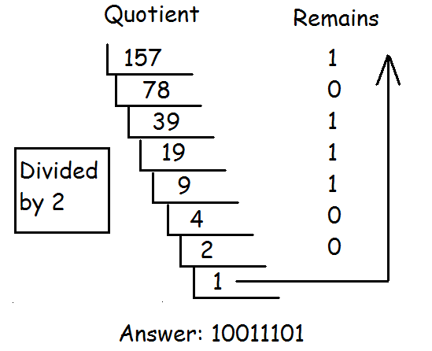
Decimal number to binary number:

Slide 19
Decimal number to binary number
Print
The Remain
to the left of
previous remains
Start
Get a
number
Divide the
Number
By 2
Is the quotient
Equal to 1?
No
Print 1
To the left of
Previous remains
End
Yes
Notes:
NOTE this flow chart has a problem!! It does not work when input is 0 or 1. It will fall into a dead loop if you put those two numbers. Figure out a way to solve this problem.

Slide 20
Example
START
Step 1: Input M1,M2,M3,M4
Step 2: GRADE ← (M1+M2+M3+M4)/4
Step 3: if (GRADE <50) then
Print “FAIL”
else
Print “PASS”
endif
Input
M1,M2,M3,M4
GRADE←(M1+M2+M3+M4)/4
IS
GRADE<50
N
Y
PRINT
“PASS”
PRINT
“FAIL”
STOP

Slide 21
Pseudo code
Flow chart in a text form.
More like a computer program, but with human language.
Can be easily translated into computer languages.

Slide 22
Elements of pseudo code
IF condition is true THEN
Process step (1)
ELSE
Process step (2)
GOTO
  Unconditional jump
If condition
Is true
Process
Step (1)
Process
Step (2)

Slide 23
Example: Binary2Decimal
Get a number
IF the number is equal to 1 or 0
  Print the number; END
Divide the number by 2
IF quotient is 1 THEN
  Print 1 to the left of the previous remains
ELSE
  Print the remain to the left of previous remains. GOTO 3
END

Slide 24
Example
Write an algorithm and draw a flowchart to convert the length in feet to centimeter.
Pseudocode:
Input the length in feet (Lft)
Calculate the length in cm (Lcm) by multiplying LFT with 30
Print length in cm (LCM)

Slide 25
Example
Algorithm
Step 1: Input Lft
Step 2: Lcm ← Lft x 30
Step 3: Print Lcm
Flowchart
START
Input
Lft
Lcm ← Lft x 30
Print
Lcm
STOP

Slide 26
Example
Write an algorithm and draw a flowchart that will read the two sides of a rectangle and calculate its area.
Pseudocode
Input the width (W) and Length (L) of a rectangle
Calculate the area (A) by multiplying L with W
Print A

Slide 27
Example
Algorithm
Step 1: Input W,L
Step 2: A ← L x W
Step 3: Print A
START
Input
W, L
A ← L x W
Print
A
STOP

Slide 28
Example
Write an algorithm that reads two values, determines the largest value and prints the largest value with an identifying message.
ALGORITHM
Step 1: Input VALUE1, VALUE2
Step 2: if (VALUE1 > VALUE2) then
MAX ← VALUE1
else
MAX ← VALUE2
endif
Step 3: Print “The largest value is”, MAX

Slide 29
Example 5
START
Input
VALUE1,VALUE2
Y
is
VALUE1>VALUE2
N
MAX ← VALUE1
MAX ← VALUE2
Print
“The largest value is”, MAX
STOP

Slide 30
NESTED IFS
One of the alternatives within an IF–THEN–ELSE statement
  may involve further IF–THEN–ELSE statement

Slide 31
Example 6
Write an algorithm that reads three numbers and prints the value of the largest number.

Slide 32
Example 6
Step 1: Input N1, N2, N3
Step 2: if (N1>N2) then
if (N1>N3) then
MAX ← N1 [N1>N2, N1>N3]
else
MAX ← N3 [N3>N1>N2]
endif
else
if (N2>N3) then
MAX ← N2 [N2>N1, N2>N3]
else
MAX ← N3 [N3>N2>N1]
endif
endif
Step 3: Print “The largest number is”, MAX

Slide 33
Example
Flowchart: Draw the flowchart of the above Algorithm.

Slide 34
Example
Write and algorithm and draw a flowchart to
read an employee name (NAME), overtime hours worked (OVERTIME), hours absent (ABSENT) and
determine the bonus payment (PAYMENT).

Slide 35
Example
Bonus Schedule
OVERTIME – (2/3)*ABSENT | Bonus Paid
>40 hours >30 but ≤ 40 hours >20 but ≤ 30 hours >10 but ≤ 20 hours ≤ 10 hours | $50 $40 $30 $20 $10

Slide 36
Step 1: Input NAME,OVERTIME,ABSENT
Step 2: if (OVERTIME–(2/3)*ABSENT > 40) then
PAYMENT ← 50
else if (OVERTIME–(2/3)*ABSENT > 30) then
PAYMENT ← 40
else if (OVERTIME–(2/3)*ABSENT > 20) then
PAYMENT ← 30
else if (OVERTIME–(2/3)*ABSENT > 10) then
PAYMENT ←20
else
PAYMENT ← 10
endif
Step 3: Print “Bonus for”, NAME “is $”, PAYMENT

Slide 37
Example
Flowchart: Draw the flowchart of the above algorithm?

